Slide 1


JeevanNet : When Silence Speaks
Listening beyond words…
PROJECT ON :- AI HEALTH DETECTOR
BY :-
PRATIK TEKALE
ARYA MOHANRAO MANDKE
ANUSHKA MANDWADE
SAMIKSHA RAVANKOLE

Slide 2
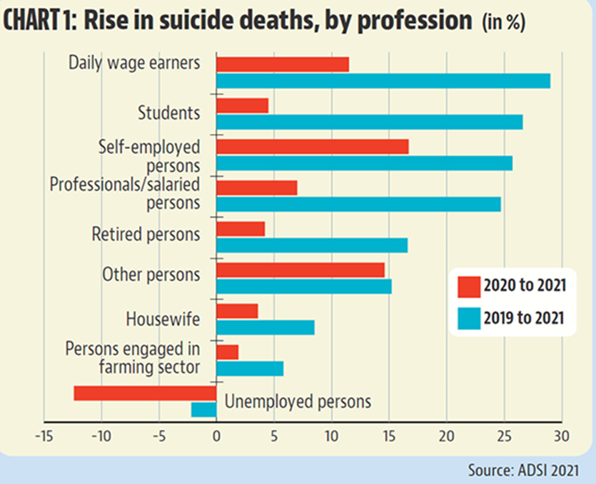
THE PROBLEM : A CRISIS WE DON’T SEE
According to the National Crime Records Bureau (NCRB), India recorded 13,044 student suicides in 2022, though there’s a 0.3% decrease from 2021. Annually the students suicide rates have increased by 2%. (IC3 Institute)
Between 2021 and 2022, male student suicides decreased by 6%, while female student suicides increased by 7%. (TOI)
Notably, student suicides now surpass those of farmers in India, highlighting the severity of the issue. (India Today)
States like Maharashtra, Tamil Nadu, and Madhya Pradesh reported the highest (Mint)
These statistics underscore the urgent need for interventions like JeevanNet to address student mental health and prevent such tragedies.

Slide 3
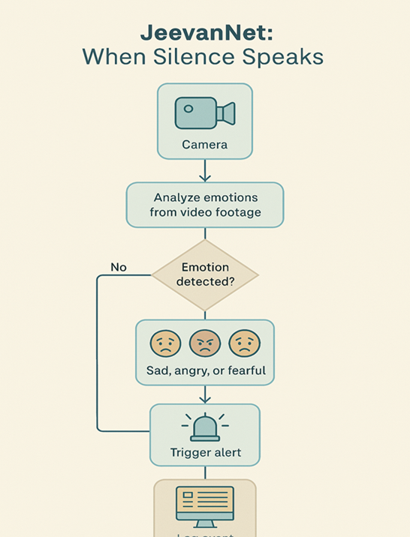
THE VISION :- A SILENT AI GUARDIAN
To catch signs of deep emotional distress before it’s too late—without waiting for the student to actively ask for help.
Build an AI system (integrated with CCTV) that: observes students' faces and behavior. Only detects signs of depression/stress/anxiety. Does not interfere with or inform the student. Sends silent alerts to mental health staff when risk levels are high
Does not detect happiness, surprise, anger. That simplifies training and improves accuracy.
Most tech-based mental health solutions require self-reporting—our approach works when students don’t or can't speak up.
With today's edge AI and emotion recognition models, it's not science fiction. We are using existing infrastructure (CCTV)—which makes it cost-effective and scalable.
Governments and NGOs are actively looking for solutions like this for CSR (Corporate Social Responsibility), NEP 2020, and school reform agendas.

Slide 4
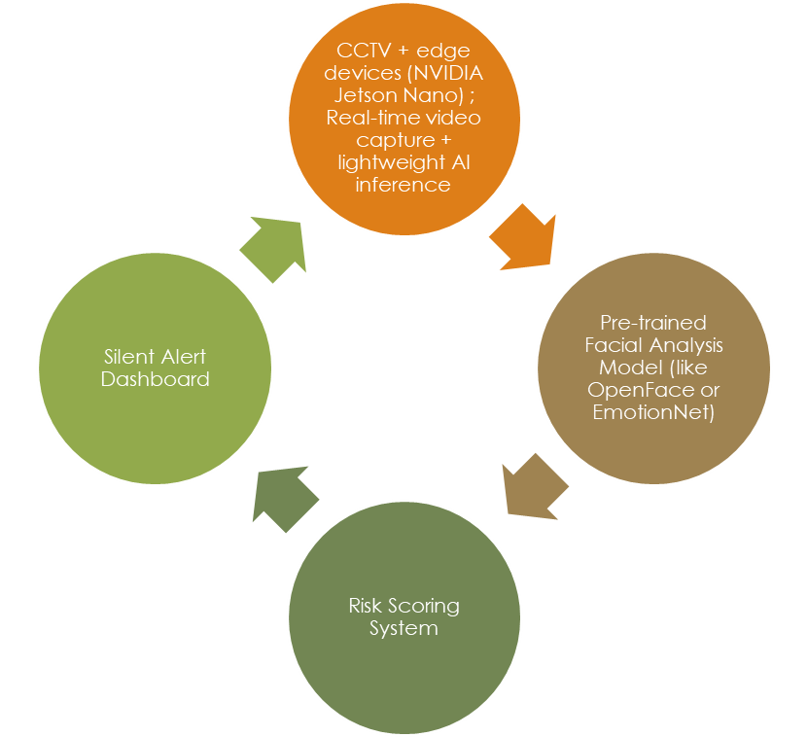
HOW JEEVANNET WORKS?
AI on edge devices (Jetson Nano): real-time facial and posture analysis. Only detects emotional distress — not joy/anger/etc. No storage of video — only emotion logs. Anonymous student IDs will be used. Trained on Indian datasets for better accuracy. Built-in 3-day rolling analysis to reduce false positives.
Slowed or lack of facial movement (flat affect), lack of eye contact or long downward gaze, repetitive movements, consistent slouched posture and long periods of social withdrawal. With time-based analysis, if these signs persist for hours or days, the system can flag the student as potentially at risk.
By training our model specifically on “depressed” vs “neutral/normal” behavior, and doing multi-day observation, it'll reduce false positives and improve early warning ability.
Example of alert: Student ID #47: signs of emotional withdrawal over past 3 days – moderate concern

Slide 5


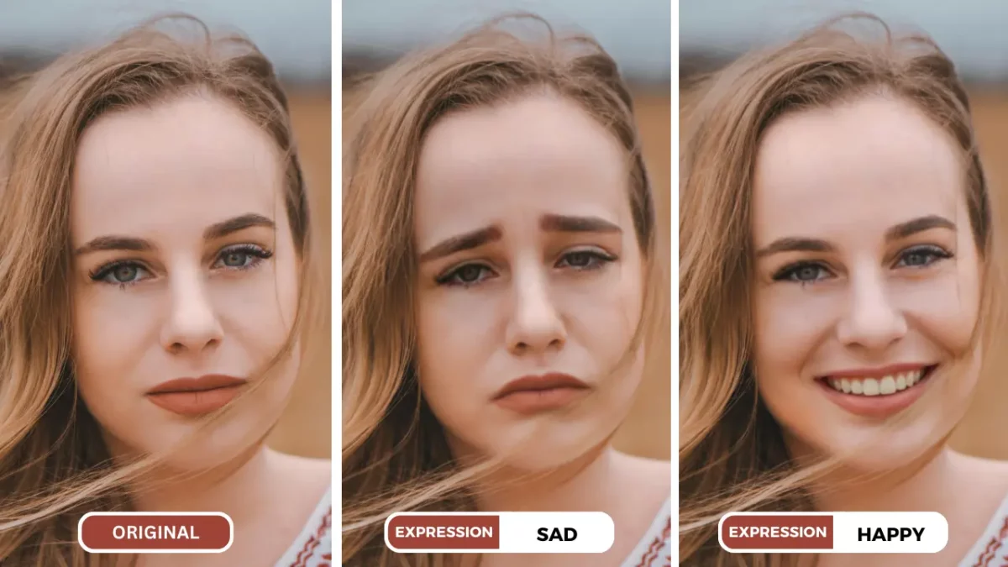
Input Code
Webcam Opens
Emotions of Face Detected
Filters the Sad emotions with respect to individual IDs
Counts the consistency of the recurring of sad IDs
Alerts the college or school system
Output Emotional Score
PROTOTYPE

Slide 6
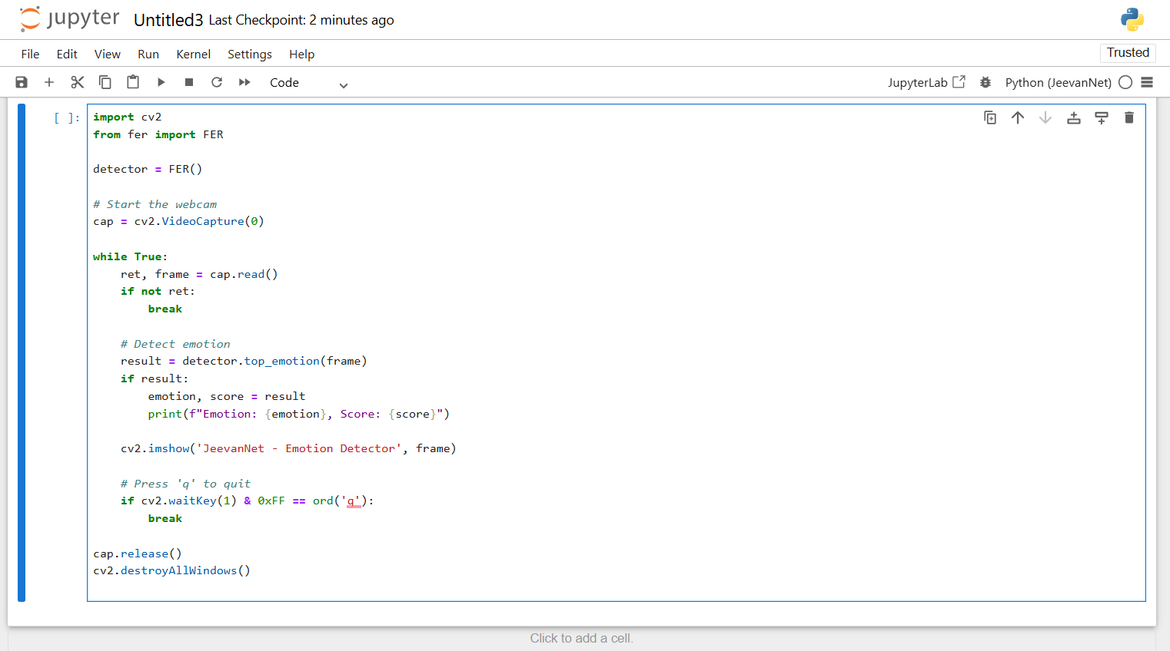
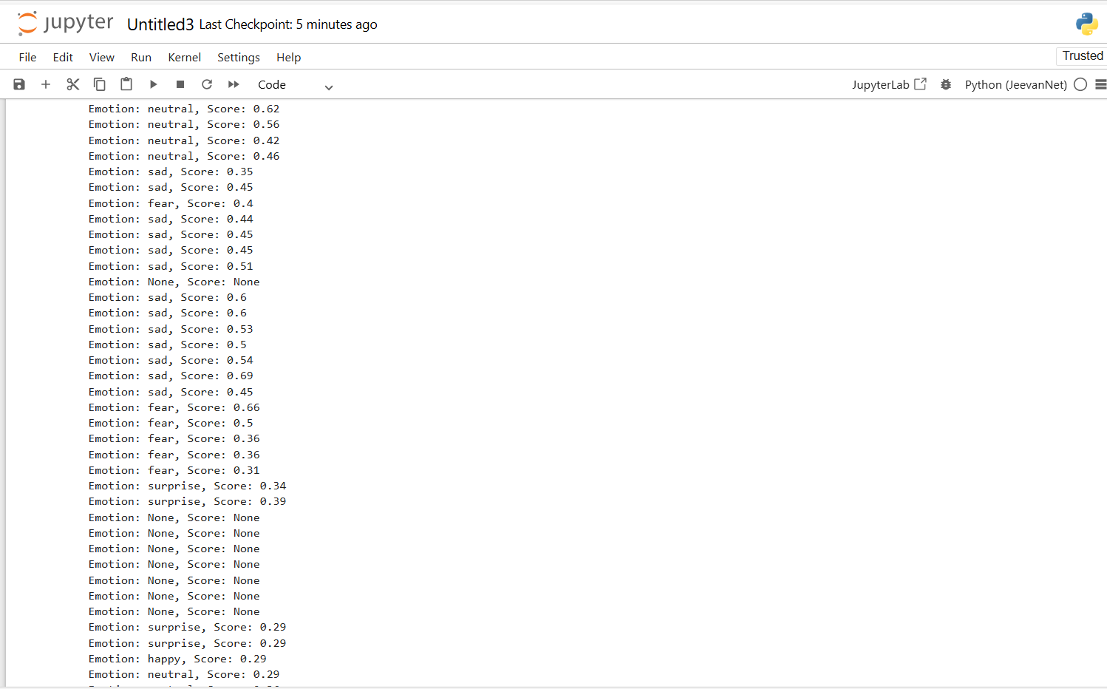

Slide 7


THANK YOU!!

